Slide 1

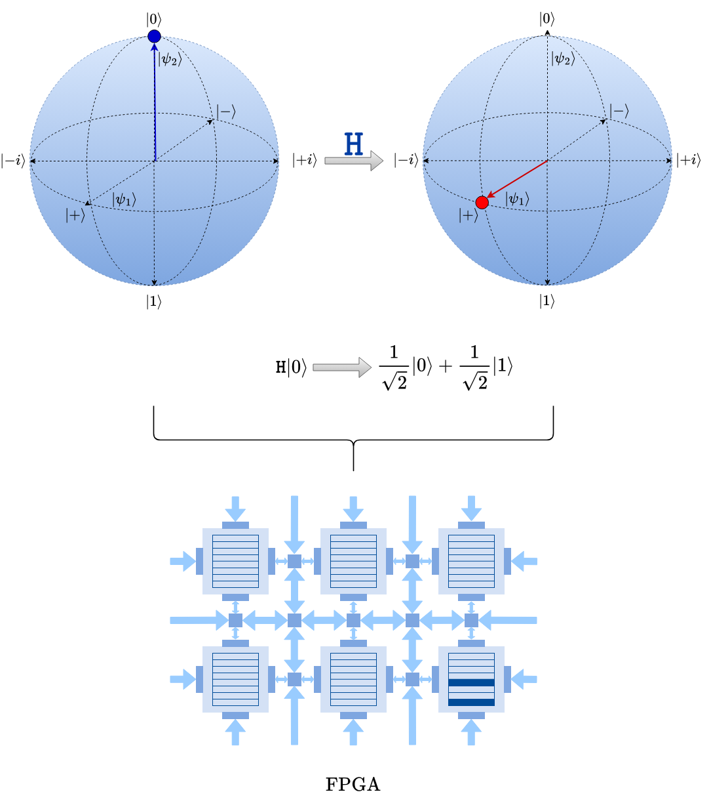
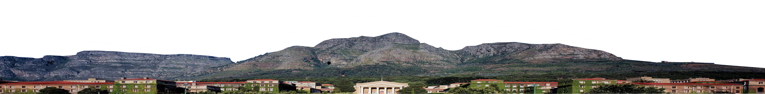
Quantum Computer Emulated on FPGA
EEE4022S 2024
Bonga Njamela, University of Cape Town, South Africa
Supervised by A. Prof. Simon Winberg, Department of Electrical Engineering
30 October 2024

Slide 2

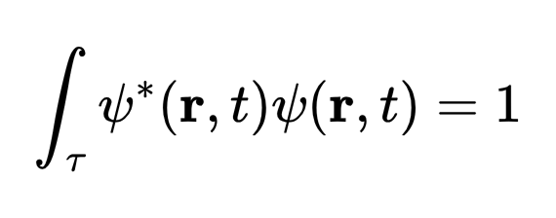

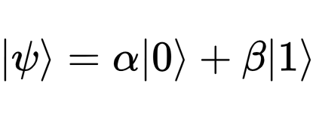
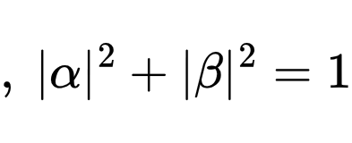

Introduction
30 October 2024
Quantum Computing
Quantum computers (QCs) are a recent technology (1982)
QCs the quantum state of particles to represent information
1121 superconducting qubits (2023)
Born's Postulate of Quantum Mechanics
1225 ytterbium-171 atom qubits (2024)​
Qubit Representation
Modern quantum computing chips include:
7000 topological qubits (2025)​
Quantum Computer Emulated on FPGA
1

Slide 3
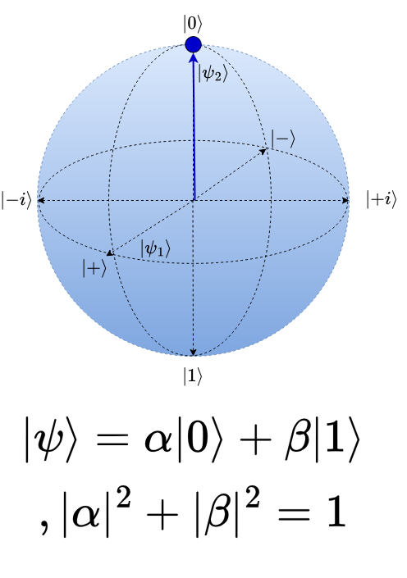
Background
30 October 2024
Understanding the Challenges of Fabricating QCs from DiVincenzo's Criteria
For a quantum computer to exist, QCs must have [1]:
A scalable physical system with well-characterised qubits
The ability to initialise the state of the qubits to a simple fiducial state
Long relevant quantum coherence times
A "universal" set of quantum gates
A qubit-specific measurement capability
Furthermore, quantum communication interfaces must have:
The ability to interconvert stationary and flying-qubits
The ability to faithfully transmit flying-qubits between specified locations
Quantum Computer Emulated on FPGA
2
[1] DI VINCENZO , D. P. The Physical Implementation of Quantum Computation. Fortschritte der Physik: Progress of Physics 48, 9-11 (2000), 771–783.

Slide 4
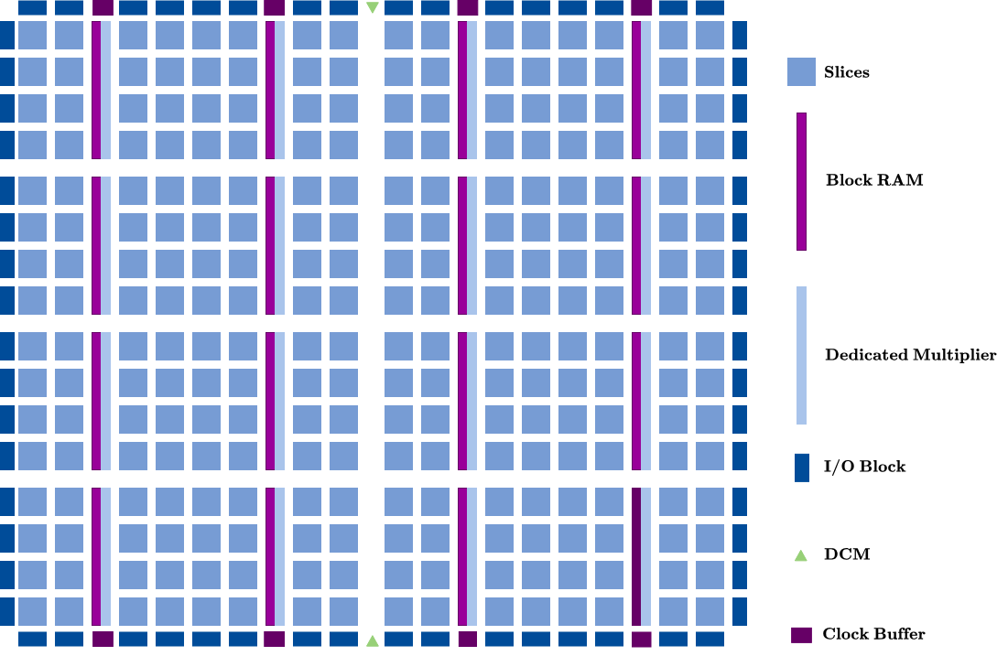
Background
30 October 2024
Capabilities of FPGAs In Relation to Emulating QCs
Cannot directly model quantum mechanics
Multiple combinational logic blocks offer intrinsic parallelism
Reconfigurable hardware for mapping behaviour of quantum circuits
Multiple resources such as LUTs, DSP, multipliers, adders and registers for performing dense matrix operations associated with quantum gates
FPGA Fabric
Quantum Computer Emulated on FPGA
3

Slide 5

Research Objectives
30 October 2024
The Aims of the Project
To create an accurate model the initialisation of well-characterised qubits to a fiducial state with sufficiently long decoherence times
To model quantum communication interface for the central QC processing component
QCEm on FPGA
To perform key quantum algorithms
Quantum Computer Emulated on FPGA
4

Slide 6
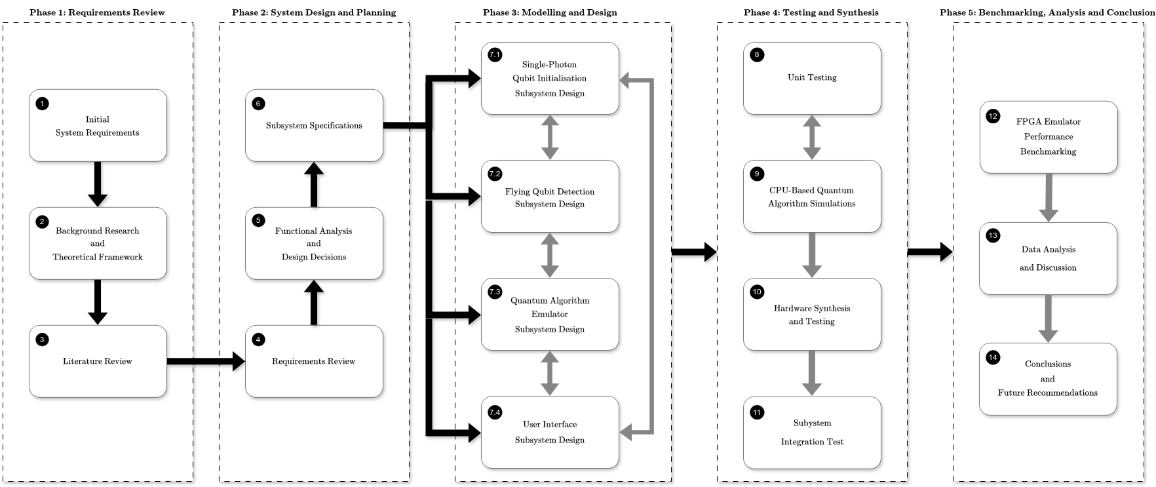
Methodology
30 October 2024
Phases in the Research and Design Process
Quantum Computer Emulated on FPGA
5

Slide 7
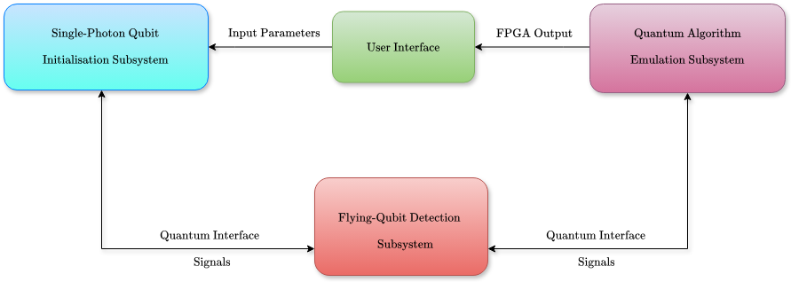
Methodology
30 October 2024
System Overview
Quantum Computer Emulated on FPGA
6

Slide 8
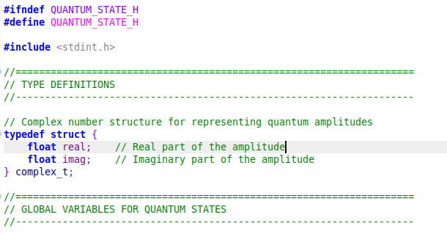
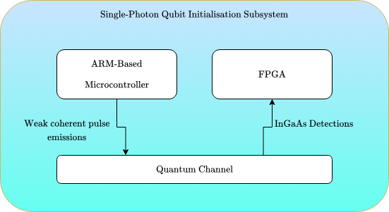
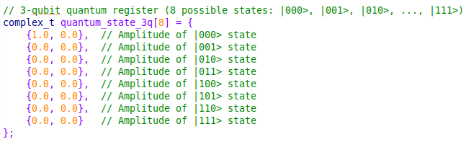
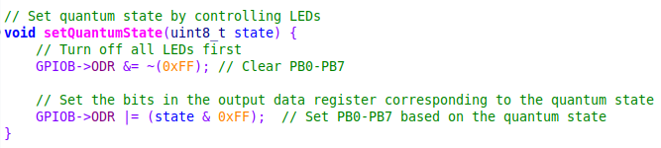
Methodology
30 October 2024
Single-Photon Qubit Initialisation Subsystem
Accurately models qubits in line with DiVincenzo's criteria for QCs
Quantum Computer Emulated on FPGA
7

Slide 9
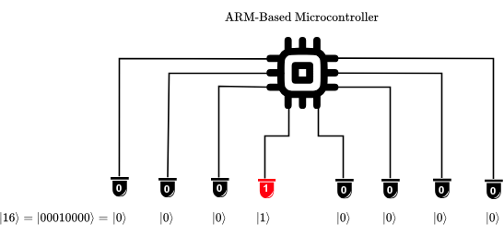
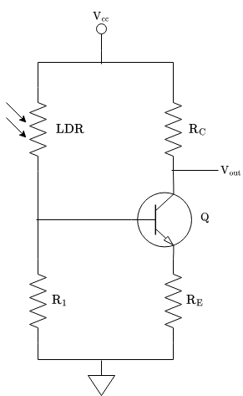
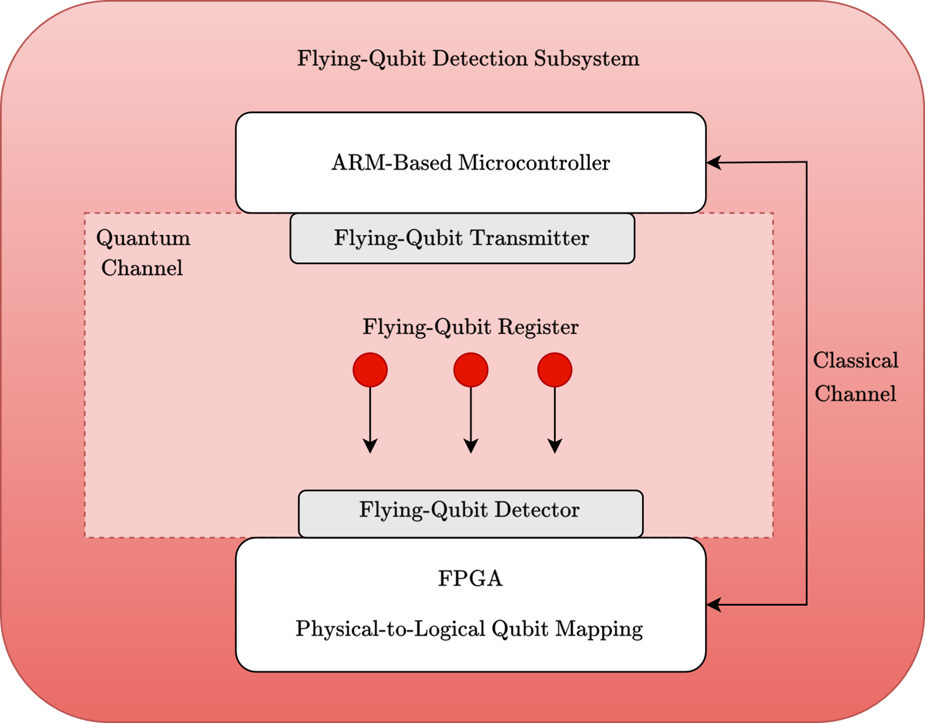
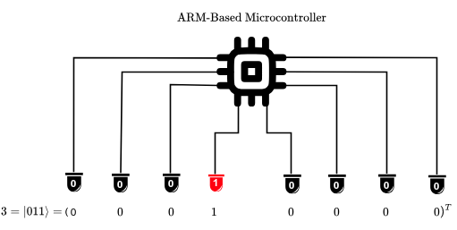
Methodology
30 October 2024
Flying-Qubit Detection Subsystem
Models a quantum channel in a QKD network
Uses two transmission modes:
Converts flying-qubits to stationary qubits within a detection window
Quantum Computer Emulated on FPGA
8

Slide 10
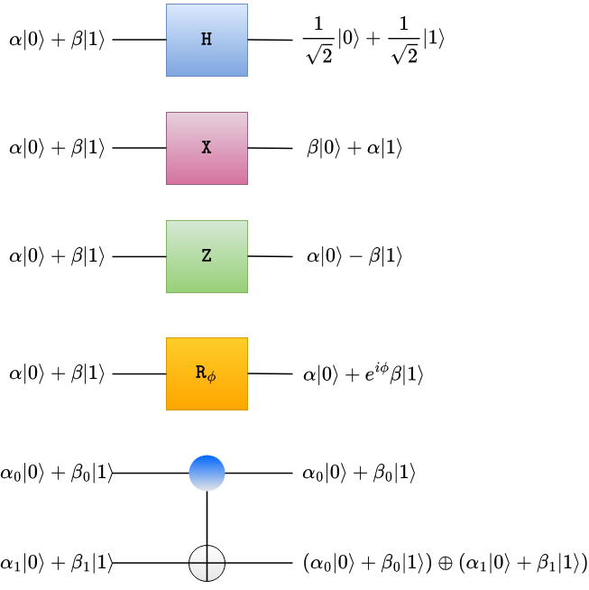
Methodology
30 October 2024
Quantum Algorithm Emulation Subsystem
Defines "universal" set of quantum gates as unitary matrices in MATLAB high-level description
Performs 4 quantum algorithms:
Quantum Teleportation (QTA)
3-Qubit Quantum Fourier Transform (QFT)
5-Qubit Quantum Factoring Algorithm (QFA)
2-Qubit Quantum Search Algorithm (QSA)
Quantum Computer Emulated on FPGA
9

Slide 11
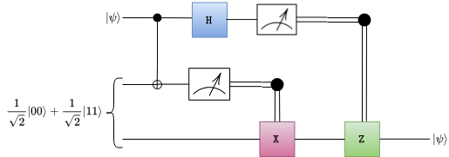
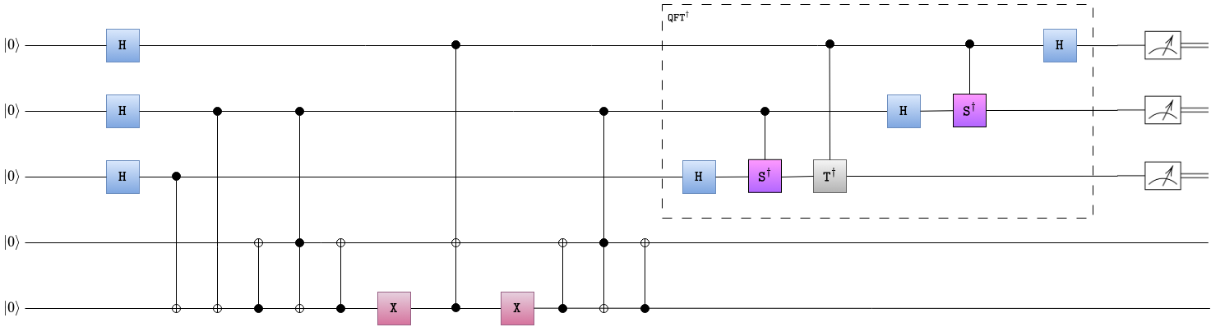
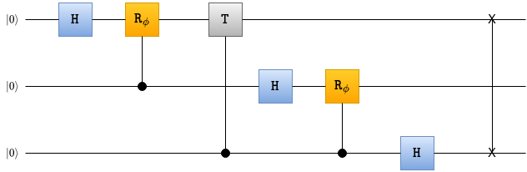
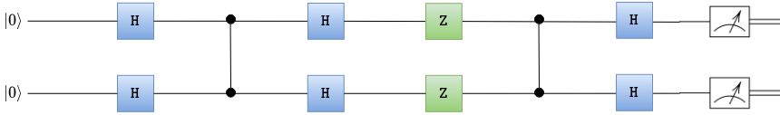
Methodology
30 October 2024
Quantum Circuits Describing Algorithms
Quantum Teleportation
Quantum Factoring Algorithm [2]
3-Qubit Quantum Fourier Transform
Quantum Search Algorithm
10
Quantum Computer Emulated on FPGA
[2] SKOSANA , U., AND T AME , M. Demonstration of Shor’s Factoring Algorithm for N = 21 on IBM Quantum Processors. Scientific reports 11, 1 (2021), 16599.

Slide 12
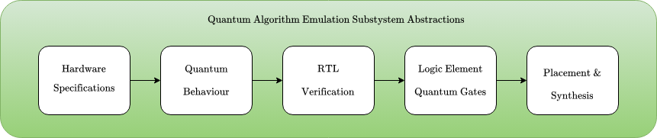
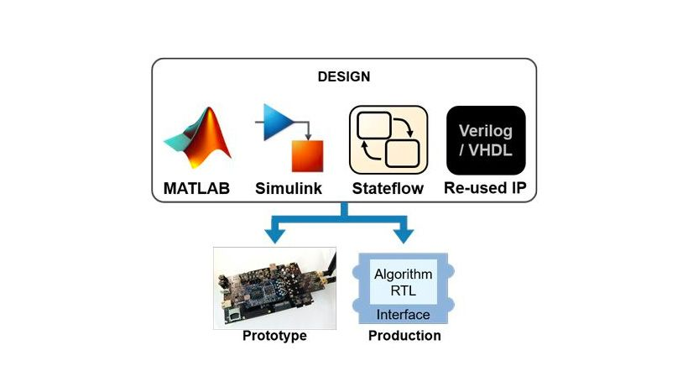
Methodology
30 October 2024
QAES FPGA Design Flow
11
Quantum Computer Emulated on FPGA
[2] SKOSANA , U., AND T AME , M. Demonstration of Shor’s Factoring Algorithm for N = 21 on IBM Quantum Processors. Scientific reports 11, 1 (2021), 16599.

Slide 13
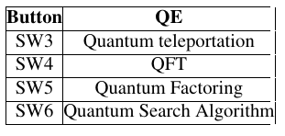
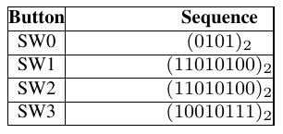
Methodology
30 October 2024
User Interface Subsystem
The main function is to allow users to select which quantum experiment they wish to perform
Nexys-A7 Switches
UCT Dev Board
12
Quantum Computer Emulated on FPGA

Slide 14
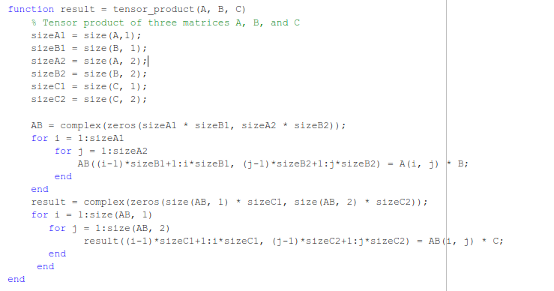
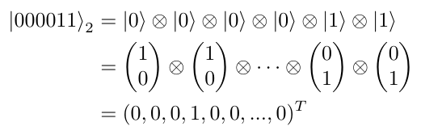
Results
30 October 2024
High-Level Description in MATLAB
The unitary matrix operations associated with qubit registers and quantum gates were described using MATLAB
Nexys-A7 Switches
13
Quantum Computer Emulated on FPGA

Slide 15
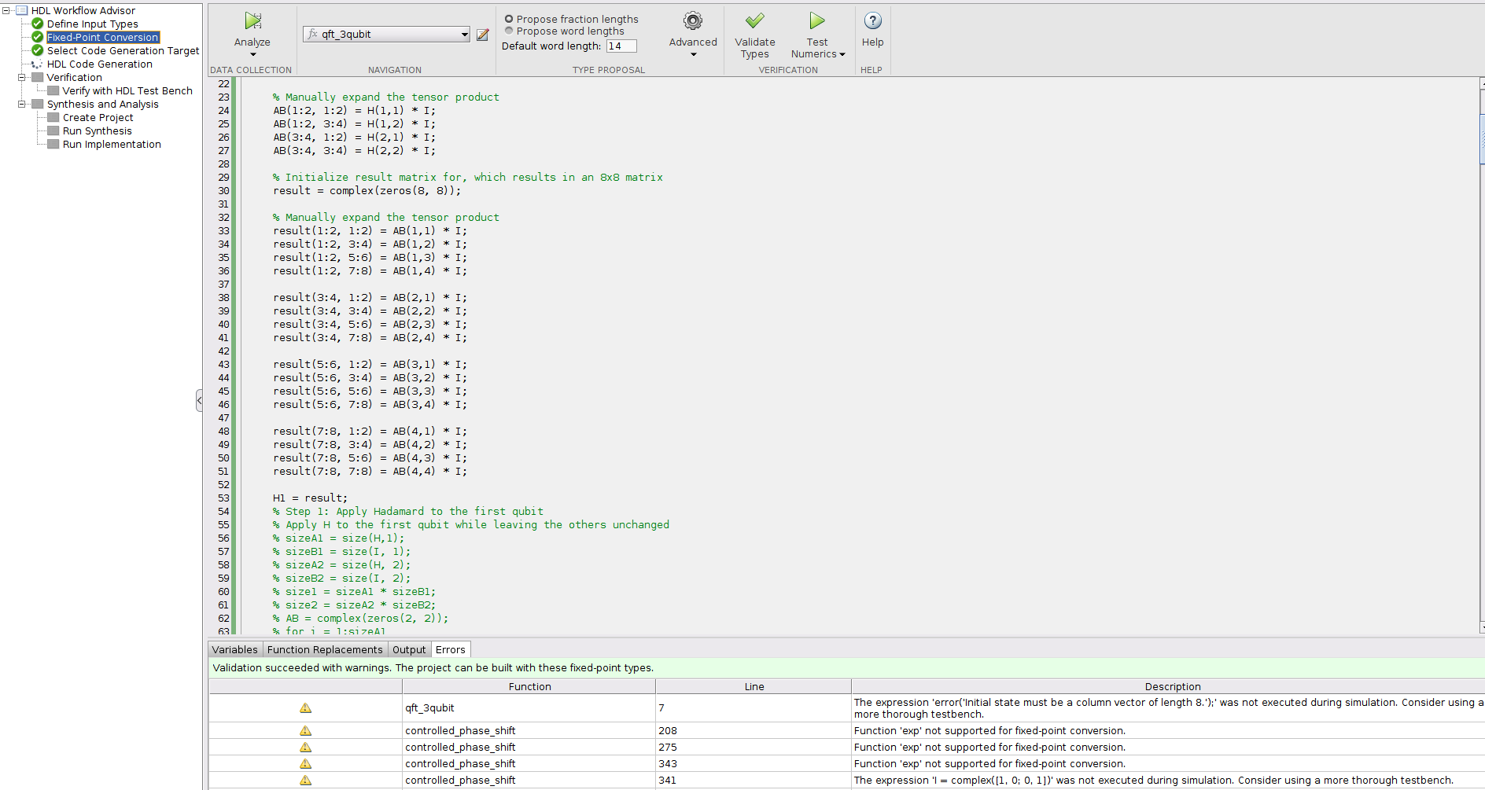
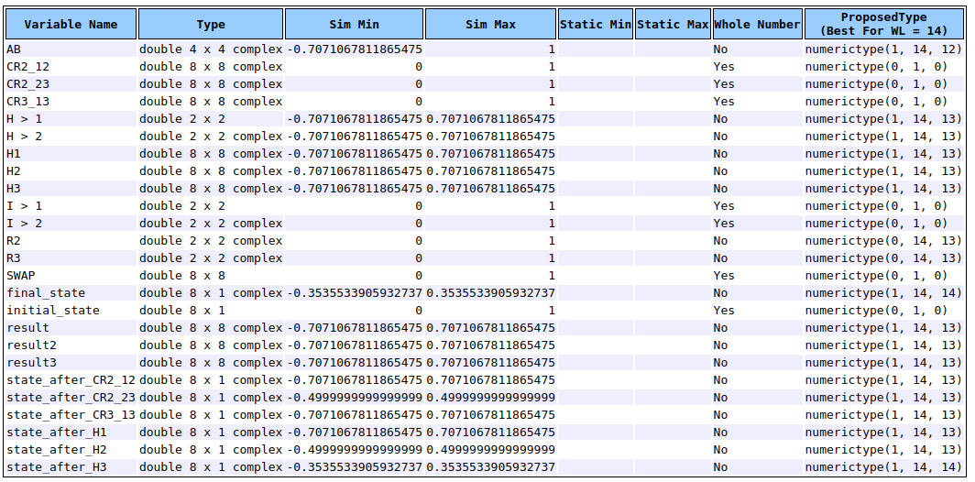
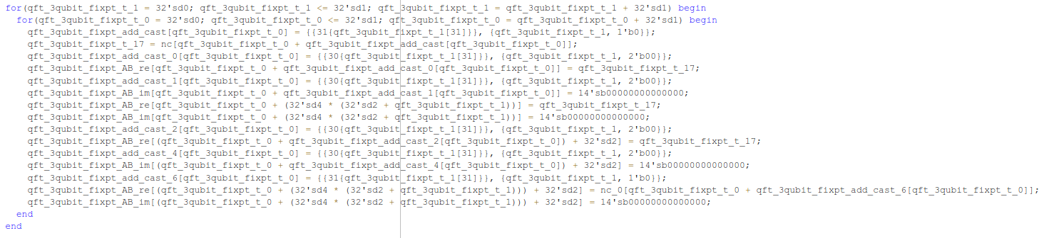
Results
30 October 2024
Conversion to SystemVerilog Using HDL Coder
A sfix14_En13 fixed-point conversion was successfully implemented using HDL Coder
14
Quantum Computer Emulated on FPGA

Slide 16
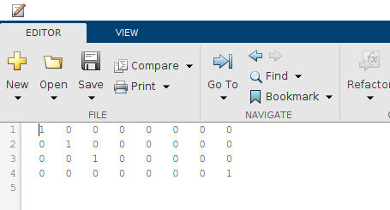
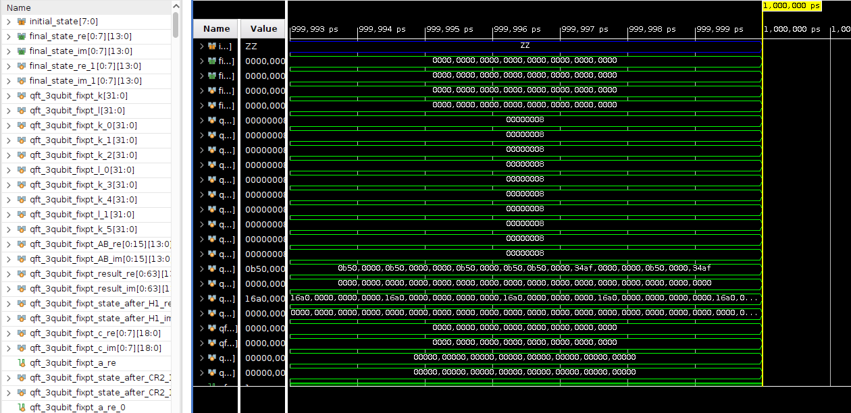
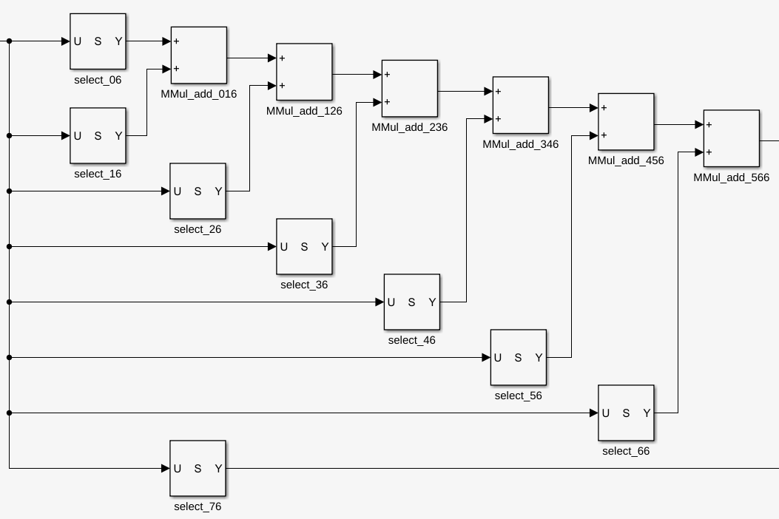
Results
30 October 2024
RTL Verification
Behavioural and timing verification was performed using waveforms, Simulink models and .dat file outputs
15
Quantum Computer Emulated on FPGA

Slide 17
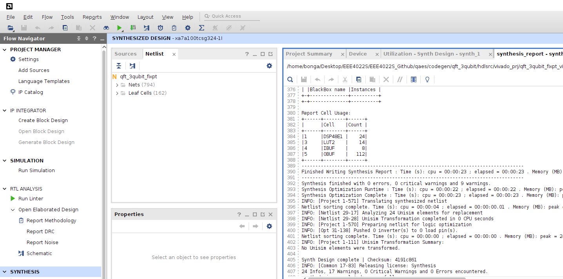
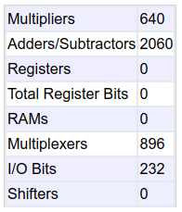
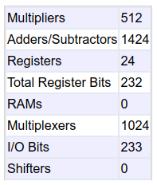
Results
30 October 2024
Synthesis in AMD Vivado
Quantum algorithms were successfully synthesised in AMD Vivado and MATLAB to show resource usage
16
Quantum Computer Emulated on FPGA

Slide 18
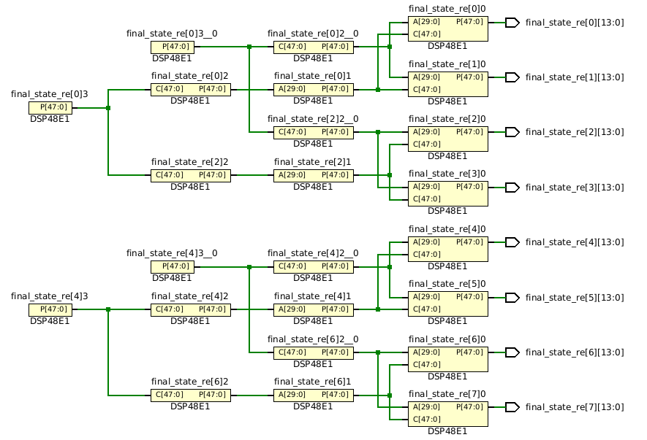
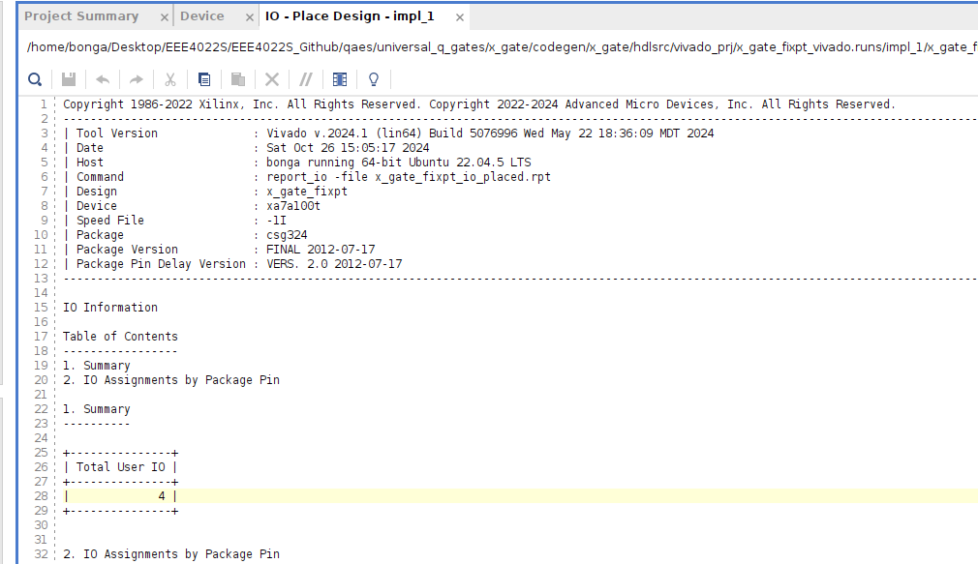
Results
30 October 2024
Implementation
Some algorithms were not successfully implemented due to requirement for more IO pins than the available 210 on the board
Quantum gates were successfully implemented
17
Quantum Computer Emulated on FPGA

Slide 19
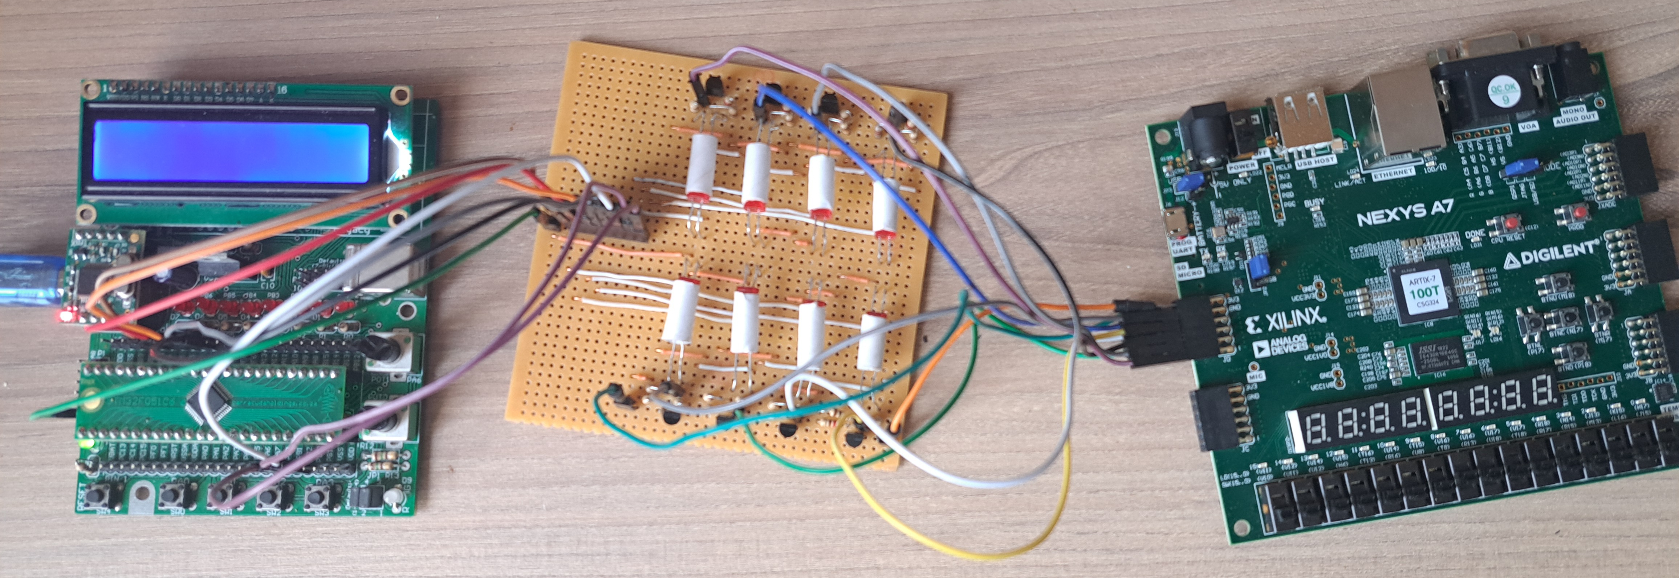
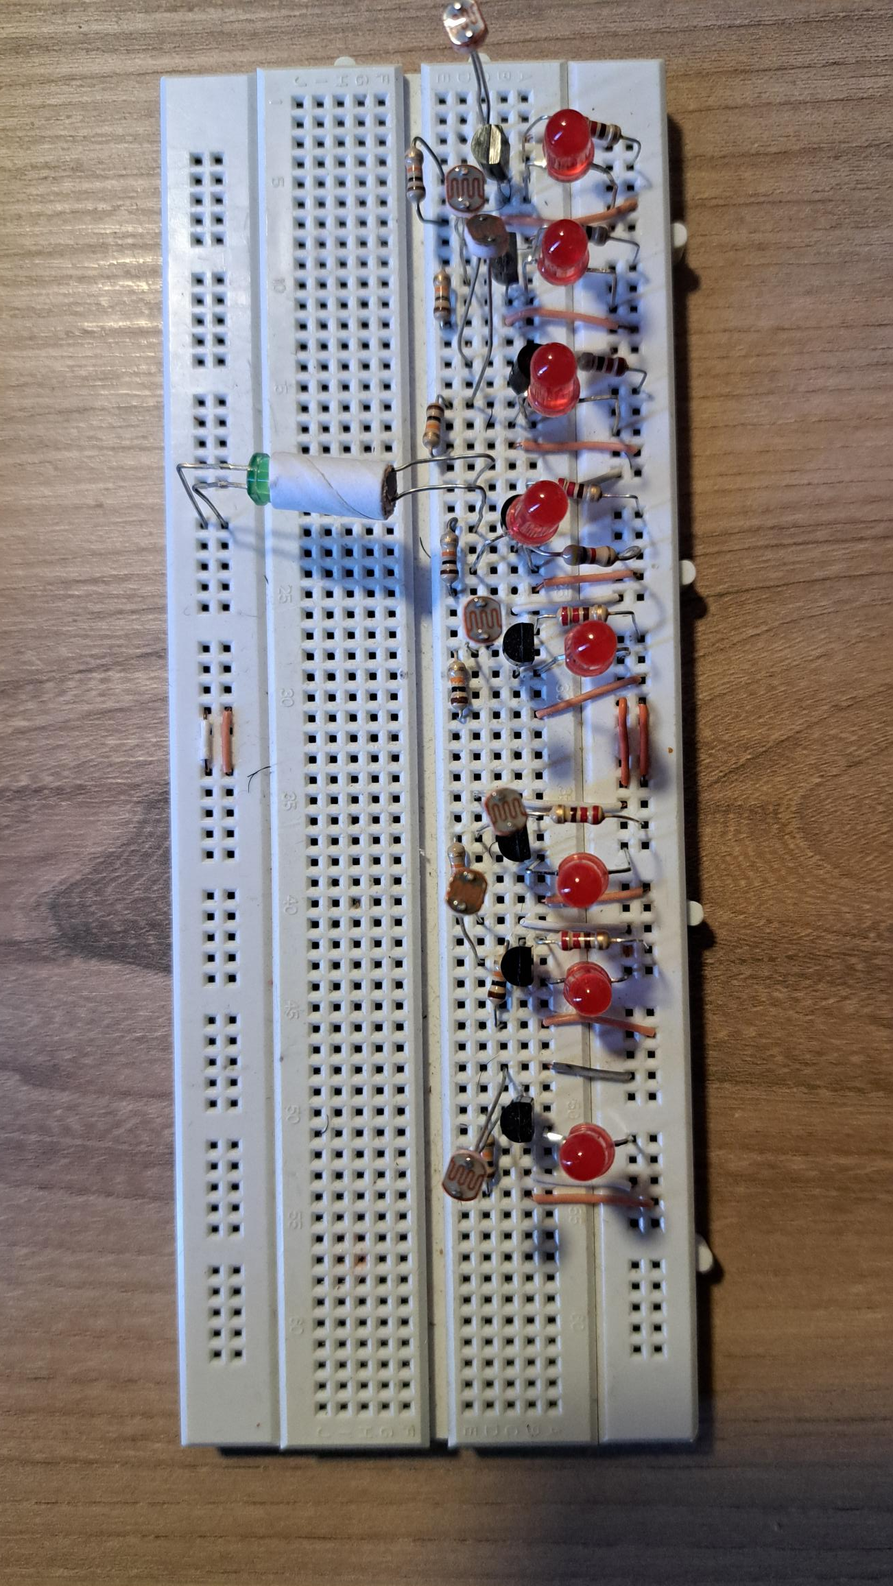
Results
30 October 2024
Hardware Design
The full quantum information system is shown below
18
Quantum Computer Emulated on FPGA

Slide 20
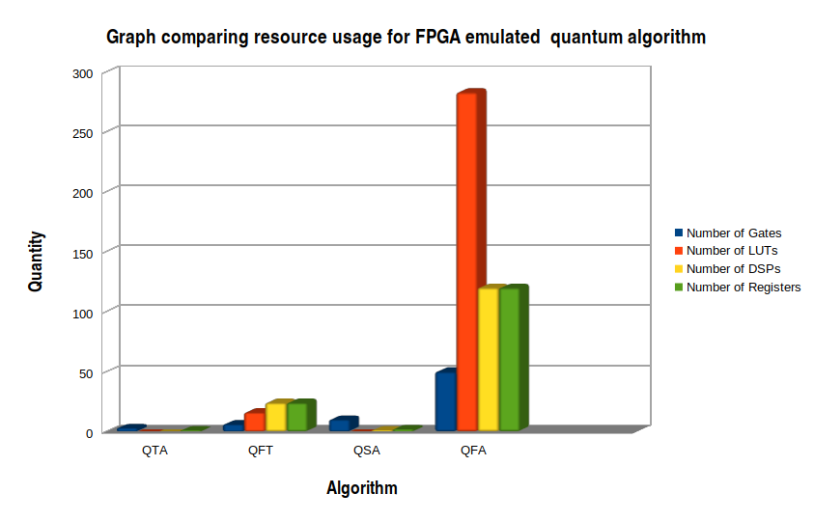
Results
30 October 2024
Summary of Resource Usage
19
Quantum Computer Emulated on FPGA

Slide 21
Conclusion
30 October 2024
Conclusion and Future Recommendations
Overall, core quantum circuit were successfully performed by the QCEm On FPGA system with minimal resource usage.
The quantum factoring algorithm was not implemented on the hardware but showed the highest resource usage due to large number of quantum gates.
Recommended integration of quantum error correction techniques such as code repetition to carry fixed-point error through the system
20
Quantum Computer Emulated on FPGA

Slide 22
Thank You!
30 October 2024
Quantum Computer Emulated on FPGA
21

